Slide 1

NAGALAND
CHIEF OF THE ARMY STAFF
UNIT CITATION 1997
MOKOKCHUNG - 1997

Slide 2


Slide 3
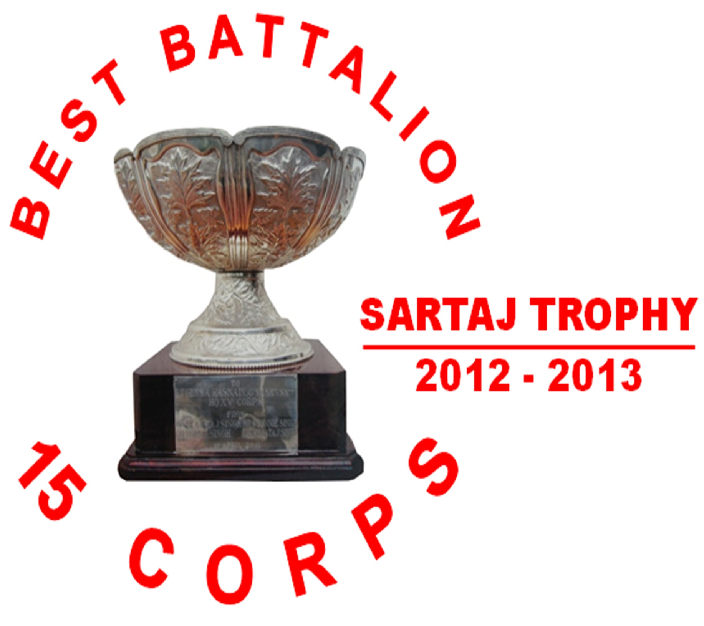

Slide 4


Slide 5
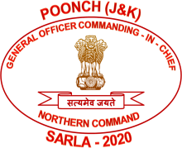

Slide 6


Slide 7


